Slide 1
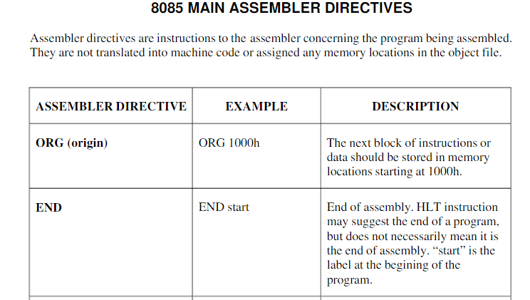

Slide 2
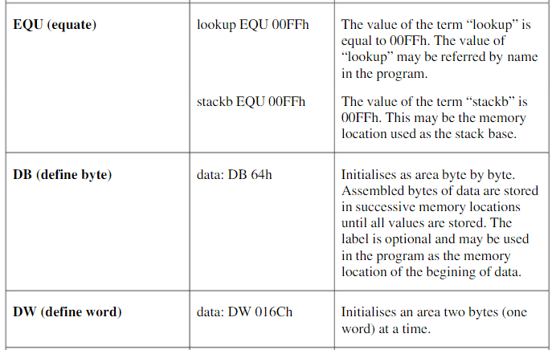

Slide 3
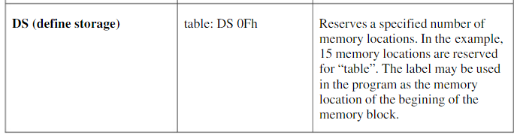

Slide 4
Subroutines
A subroutine is a group of instructions that will be used repeatedly in different locations of the program.
Rather than repeat the same instructions several times, they can be grouped into a subroutine that is called from the different locations.
In Assembly language, a subroutine can exist anywhere in the code.
However, it is customary to place subroutines separately from the main program.

Slide 5
Subroutines
The 8085 has two instructions for dealing with subroutines.
The CALL instruction is used to redirect program execution to the subroutine.
The RET instruction is used to return the execution to the calling routine.

Slide 6
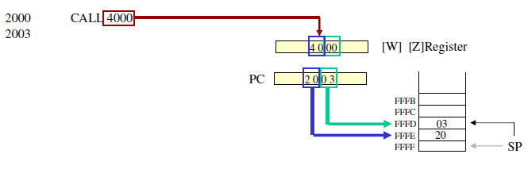
The CALL Instruction
CALL 4000H
3-byte instruction.
Push the address of the instruction immediately following the CALL onto the stack and decrement the stack pointer register by two.
Load the program counter with the 16-bit address supplied with the CALL instruction.
Jump Unconditionally to memory location.

Slide 7
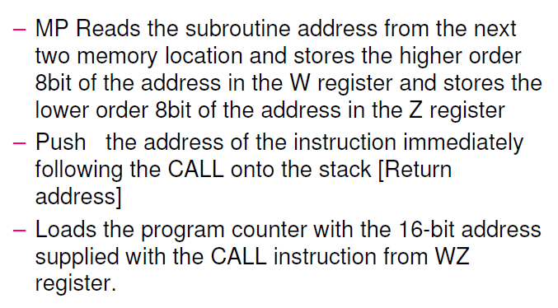
The CALL Instruction

Slide 8
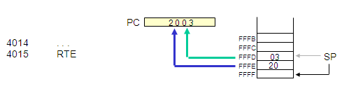
The RET Instruction
RET
1-byte instruction
Retrieve the return address from the top of the stack and increments stack pointer register by two.
Load the program counter with the return address.
Unconditionally returns from a subroutine.

Slide 9
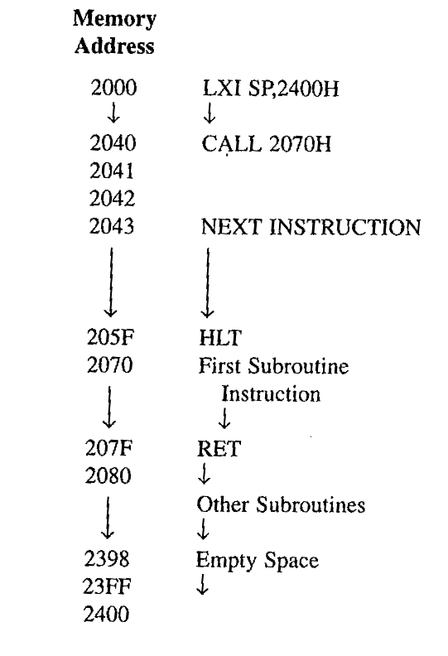
Illustrates the exchange of information between stack and Program Counter

Slide 10
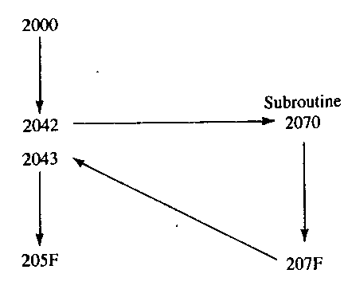
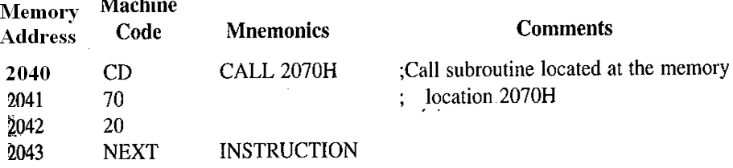
Program Execution

Slide 11
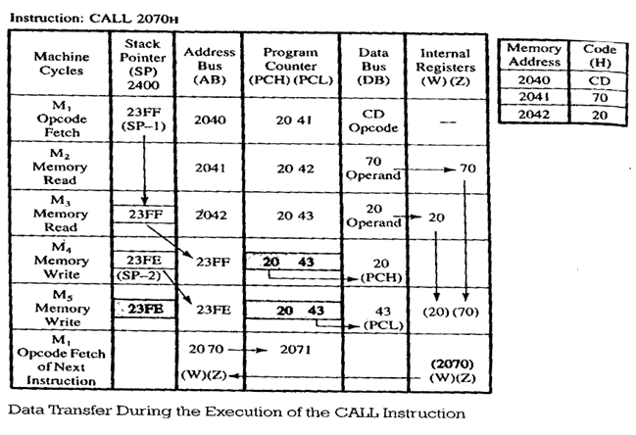
CALL Execution
Instruction requires five machine cycles and eighteen T-states: Call instruction is fetched, 16-bit address is read during M2 and M3 and stored temporarily in W/Z registers. In next two cycles content of program counter are stored on the stack (address from where microprocessor continue it execution of program after completion of the subroutine.)

Slide 12
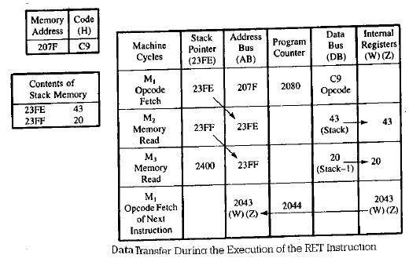
RET Execution
Program execution sequence is transferred to the memory location 2043H location.M1 is normal fetch cycle during M2 contents of stack pointer are placed on address bus so 43H data is fetched and stored on Z register and SP is upgraded. Similarly for M3. Program sequence is transfered to2043H by placing contents of W/Z on address bus.

Slide 13
Subroutine Documentation and parameter passing
Various Information are passed between calling program and a subroutine, a procedure called parameter passing
It is important to document a subroutine clearly and carefully
The documentation include
1.Function of subroutine
2.Input/Output parameters
3.Registers used or modified
4.List of other subroutines called by this subroutine

Slide 14
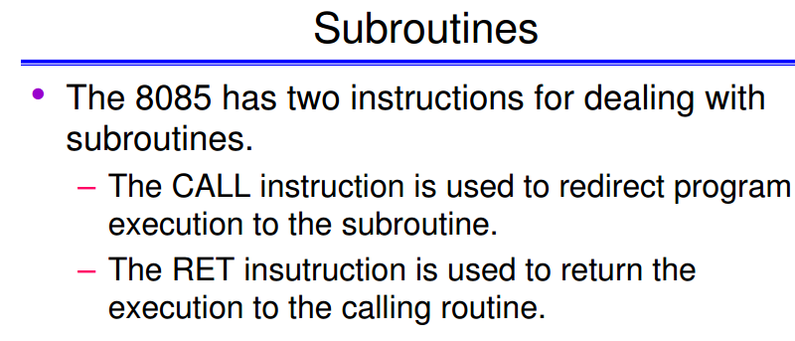

Slide 15
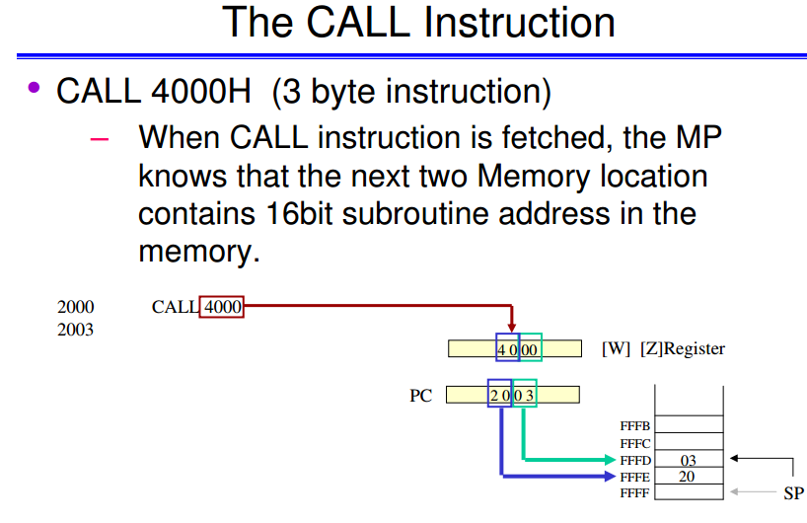

Slide 16
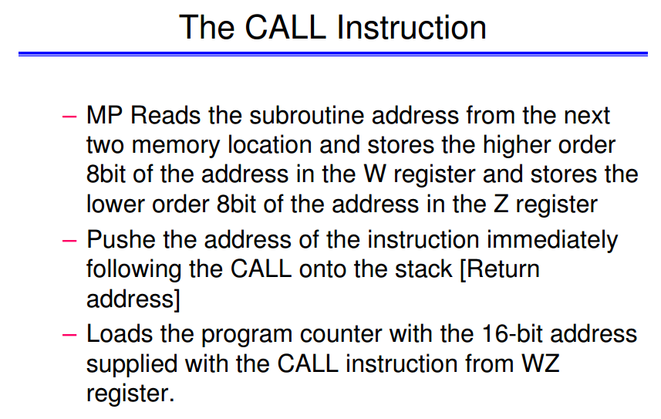

Slide 17
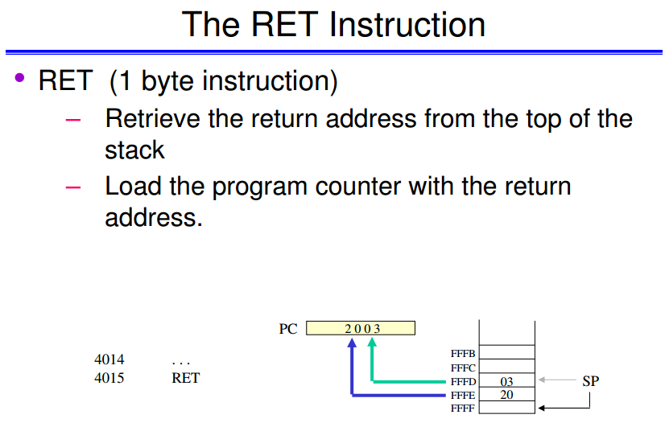

Slide 18
